Slide 1
University values for today: internal perspectives New Management Model in Hungary
Csaba Deák, PhD
(Chancellor, University of Miskolc, Hungary)
University values for today: Central European perspectives and challenges
XXIX Anniversary of the Magna Charta Universitatum

Slide 2
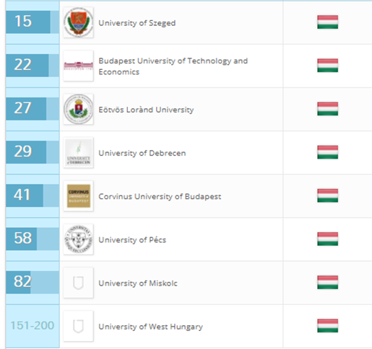
Facts on Hungarian Higher Education System
Total number of accredited higher education institutions: 65
State (public) HEIs -- 28
Non-state (private) HEIs -- 37
QS University Rankings for Eastern Europe and Central Asia (2016)
World Rankings
501-550
701+
701+
651-700
701+
701+
290,000 students (2016)
201,000 attending BA/BSc courses
37,000 participating in MA/MSc courses
7,350 in doctoral studies (PhD/DLA).
Percentage of female students - over 54%
20,200 professors, teachers and researchers
17,050 working in state-subsidized institutions
https://www.topuniversities.com/university-rankings

Slide 3
Chancellor System in Hungary
“Previously, rectors had final responsibility for all decisions made by universities. Since 2014, (Act CCIV on National Higher Education), there is a chancellor appointed by the Prime Minister in each public higher education institution. Chancellors are executive heads with final responsibility for financial and economic decisions, while rectors retain final responsibility for teaching and research decisions. As academic and financial decisions are typically closely linked, chancellors have a crucial position in the steering of universities, including effective allocation of resources.”
http://www.oecd.org/edu/Hungary-Profile.pdf
Ministry
Rector
cooperation
Chancellor
Educational, research organizational units
Faculties
Institutions, departments
Doctoral schools
Functional organizational units
Management
Law, administration
Operations etc.
Units of organizational service
Dormitories
Library etc.
Strategic control
Strategic and operational control

Slide 4
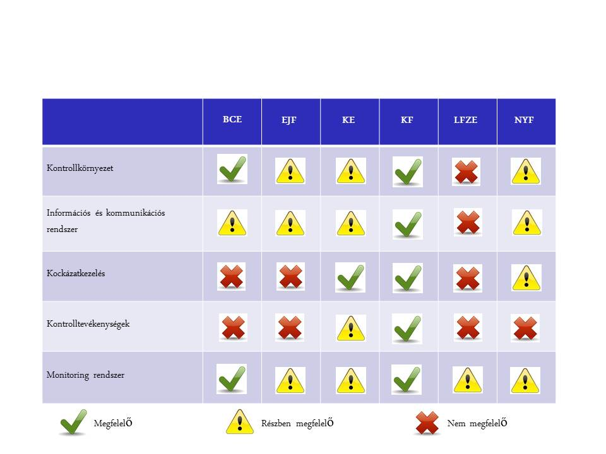
Findings of two Comprehensive Audits
State Audit Office of Hungary (SAO)
The Government Control Office (GCO)
1
… do not comply with many applicable national rules.
… breach their obligations due to lack of proper internal regulation systems, such as …
Hungarian Universities (A-F)
A
B
C
D
E
F
Background of this Management Reform
Control Environment
Information and Communication System
Risk Management
Control Activities
Monitoring System
Acceptable
Partially acceptable
Not acceptable
… financial management of the Universities is not transparent.
… decision making processes were not economically justified.
Source: Ministry of Human Capacities in L. Pavlik; The New Management System of the Hungarian Public Universities

Slide 5
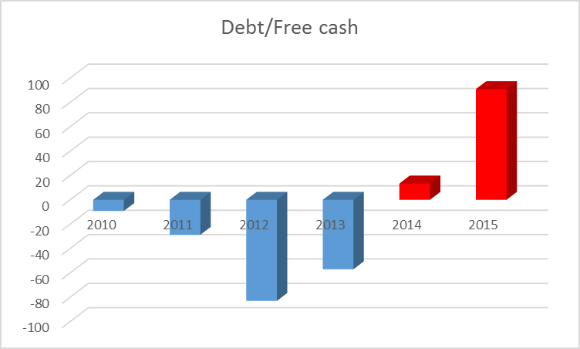
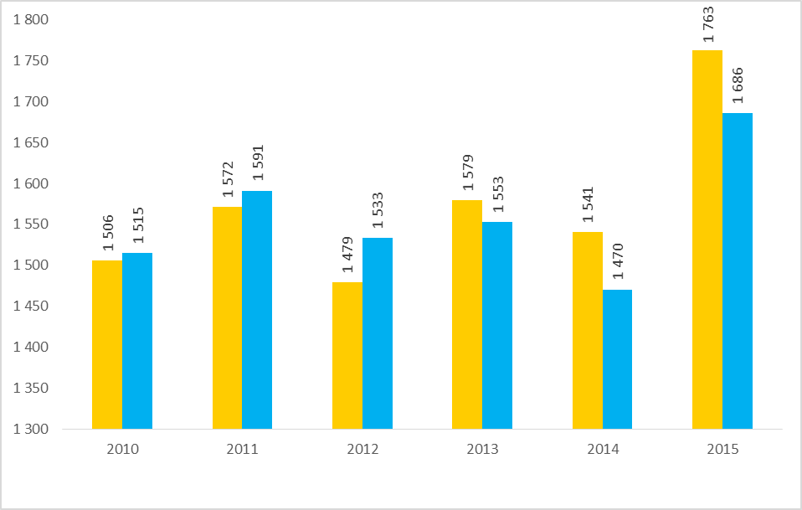
Most institutions suffered from insolvency
increase in unused capacity due to decreasing student numbers (esp. outside of Budapest) and PPC construction
2
Source: Ministry of Human Capacities
Background of this Management Reform
- 23%
Total revenue (Eur/million )
Based on: L. Pavlik;
Total expenditure (Eur/million)

Slide 6
Unclear division of responsibilities between
Rector and Senate
State and institution
3
Rector – first leader -personal responsibility
Senate – decision-making body -
“body responsibility”
Who is responsible for decisions of the Senate?
Background of this Management Reform
Ministry of Human Capacities
University
University
University
University
University
University
University
University
University
University
University
University
Lack of proper state control under the financial management.
Source:http://doktori.bibl.u-szeged.hu/3932/1/Ronay_Zoltan_ertekezes_nyilvanos_vita.pdf in L. Pavlik; The New Management System of the Hungarian Public Universities

Slide 7
The Chancellor System: Criticisms
More bureaucracy, a new level of administration, less flexibility
Leads to fiscal approach (cost effectiveness) rather than institutional development approach
Too much power to override decisions on education and research – everything has a financial aspect
Depends too much on personal factors:
chancellor’s managerial approach
chancellor’s (lack of) familiarity with HEI
Chancellor can be easily replaced by ministry – leads to less risk-taking
Short (3-year) term discourages long-term strategical planning
Leads to reduced role/autonomy of faculties within HEI
System implemented too rapidly, poor preparation
(Based on A kancellári rendszer bevezetése a magyar felsőoktatásban Tapasztalatok és várakozások; 2016. G. Kováts (ed.). pp. 37-38) / Dual leadership in higher education: the introduction of the „chancellor system” in Hungary 2016. G. Kováts

Slide 8
Survey responses (Opinions of Chancellors) : Most important benefits of the Chancellor System
Transparent, effective and more stable financial management
Honest knowledge sharing among institutions
Strategic perspective on everyday activities
More transparent assignment of responsibilities: Chancellor bears personal responsibility, has right to approve Senate decisions with financial impact.
Allows system-oriented management in HE without endangering autonomy in academic, educational or research matters
More effective and direct cooperation between ministry and institution and among institutions
Reducing redundancy in operational matters between central and faculty administration
More open to industry and business stakeholders, considering interests of the whole university (the Big picture)

Slide 9
Typical Actions
Responsible management of property assets – utilization of not used asset units targeting non-education functions (typical PPP buildings)
Overview of external contracts : re-negotiating contracts, terminating contracts with bad conditions, etc.
Overview of income structure: reduction of payments without performance, reduction of income inequalities, setting wage ceiling.
Reduction of inefficient activities : setting a minimum number of students for electives, etc.
Cooperation between institutions: common procurement or sharing building space etc.
Rationalization and cost reduction measures
Based on L. Palkovics; Hungarian Tertiary Education – Vision, Strategy and Realization

Slide 10
Survey responses (Opinions of Chancellors) : Most important barriers to the Chancellor System
Operation of HEI is complex; time and energy are needed to identify interrelations and unseen connections
Open and hidden resistance to new system:
Fear of losing influence and power
Feelings of superiority on the part of some scholars
Frustration with interference: “The ministry has come up with another new scheme…here we go again”
Misinterpretation of autonomy – in practice, often anarchy
Attracting and keeping administrative staff and experts to support operational activities, due to uncompetitive salaries
Academic staff perceive adminstrative matters to be more complicated and blame this on the chancellery system; they often do not recognize that the same regulatory requirements also existed earlier
Meeting strategic aims largely depends on the decisions of the academic leaders

Slide 11
Survey responses: Contributions of the Chancellor System to University Values
Fostering HE network to understand and meet socioeconomic needs/demands, offering constructive responses to educational and occupational issues of demographic change
“Knowledge factory”: transmitting knowledge to stakeholders directly (R&D) or indirectly (graduates).
Preparing the next generation of responsible, intelligent citizens
Providing services to support academic side in producing educational & research results (added value activities)
Cooperating, coordinating activities, promoting best practices among universities
Encouraging income-producing activities, RDI

Slide 12
University values for today: internal perspectives New Management Model in Hungary
Csaba Deák, PhD
(Chancellor, University of Miskolc, Hungary)
University values for today: Central European perspectives and challenges
XXIX Anniversary of the Magna Charta Universitatum

